Slide 1
FY 2026-2027 Budget Updates
BWP Board
April 2, 2026
Joseph Lillio
Chief Financial Officer
Notes:
Good evening, Chair and Board Members.
Tonight, staff is presenting to you the updated FY 2026-27 Budget. This is the 2nd year of the two-year budget presented to the Board last year.
I would also like to thank all the Assistant General Managers and their budget teams for the many hours, hard work, and dedication put in to ensure the updated FY 2026/27 budget although with an increase in authority, remain net neutral with offsets / savings found within our organization. Their dedication to customer service excellence will ensure BWP adheres to the original two-year budget and rate plan that was presented to the Board last year.
I would like to request that you reserve questions until the end.

Slide 2


Summary of Changes
Overall, an increase in budget authority due to the following:
  Position budgeting driven by union negotiations
  Addition of new positions driven by regulatory mandates & compliance
  Unfunded Actuarial Liability Pension (UAL)
  Increase will be funded with unplanned revenue sources and cost savings
  Lower projections for load and revenue (electric & water) based on trend
  Water bond issuance

Slide 3
Budget Authority by Fund
(as presented to Board in March versus April)
($ in 000’s) | Adopted FY 2025-26 | March 2026 FY 2026-27 | April 2026 FY 2026-27 | Increase / (Decrease)
Electric Fund | $415,426 | $358,846 | $357,989 | ($857)
Water Fund | $71,956 | $98,314 | $98,086 | ($228)
Communications Fund | $6,642 | $6,543 | $6,534 | ($9)
Street Lighting Fund | $5,168 | $4,198 | $4,199 | $1
MPP Operating Fund (SCPPA) | $27,809 | $32,068 | $32,342 | $274
Tieton Operating Fund (SCPPA) | $2,183 | $2,375 | $2,375 | $0
Total Authority | $529,184 | $502,344 | $501,525 | ($819)
Notes:
The electric Fund was reduced by $857k:
Power Supply reduced professional services budget line item by $266k
The remaining $591k is a reduction in PERS costs
Water Fund – Reduction in PERS costs - $228k
Comm fund – reductions in PERS costs
MPP fund – capital purchase of $274K for a backup generator
Although there have been an increase in budget authority, the team have found savings and offset to ensure we remain net neutral and well within the approved rate increases.

Slide 4

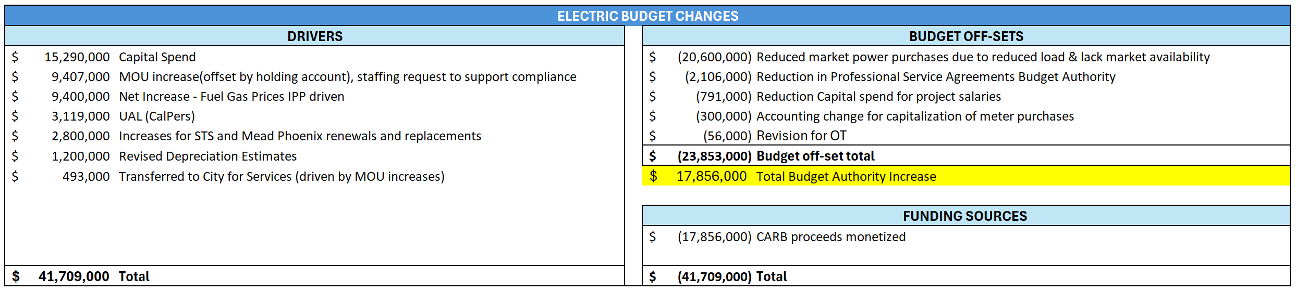
Budget Changes for Electric Fund
Notes:
Changes –
The electric Fund was reduced by $857k:
Power Supply reduced professional services budget line item by $266k
The remaining $591k is a reduction in PERS costs
Power reduced $443K ($266K reduction in PSA rest PERS)
Distribution 353K reduction in PERS
OT $56K reduction in PERS

Slide 5
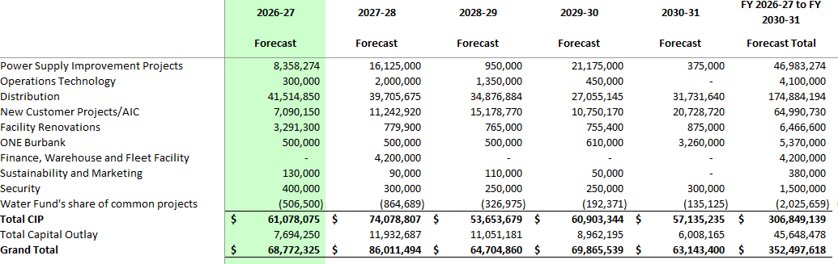
Electric Five-Year Capital Plan
Notes:
No electric capital changes since the March Board meeting.

Slide 6
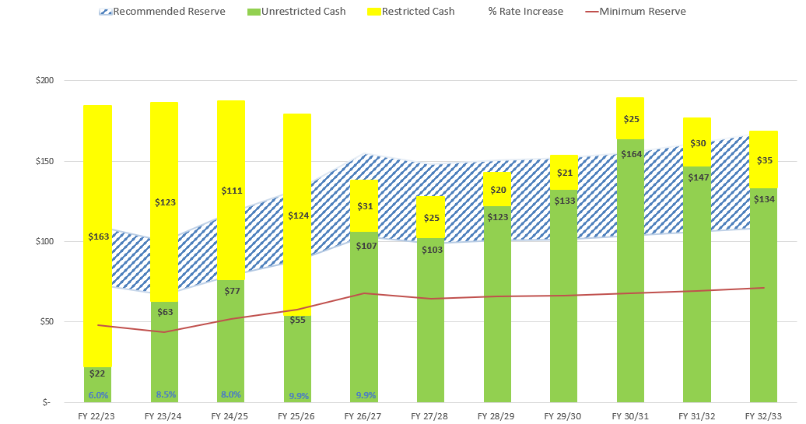
History & Forecast of
Electric Cash Reserves
($ in millions)
Notes:
Changes since March Board meeting:
updated with December actuals
updated with January actuals
corrected FY 26/27 interest income formula to pick up forecasted ending FY 25/26 cash and not budgeted ending FY 25/26 cash
updated FY 26/27 with updated O&M

Slide 7

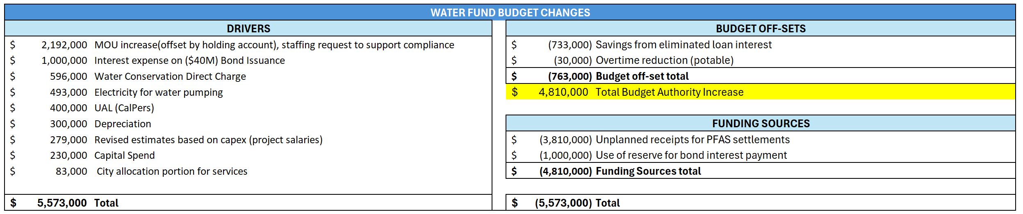
Budget Changes for Water Fund
Notes:
Reduction in PERS costs - $228k
$2m a year for san diego water for 5 years asset , but net impact is $1m a year

Slide 8
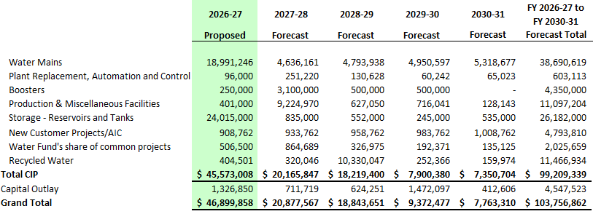
Water Five-Year Capital Plan
Notes:
Water capital changes since March:
No change to FY 2026-27
Potable CIP – Miscellaneous Facilities went down $5M in 30/31 due to:
• Please push back the $5m currently in FY 30-31 for Valley Pumping Plant Office/Lab Expansion back one year to FY 31-32.
Recycled CIP- Recycle water went down by $7.5m in 29/30 and $750k in 30/31 due to:
• For the Potable Reuse - Study/Program, please push back the $7.5m in FY 29-30, the $750k in FY 30-31, and for the 10 year forecast - $82.5m in FY 31-32 was pushed back 3 years to FY 32-33, FY 33-34, and FY 34-35 respectively.

Slide 9
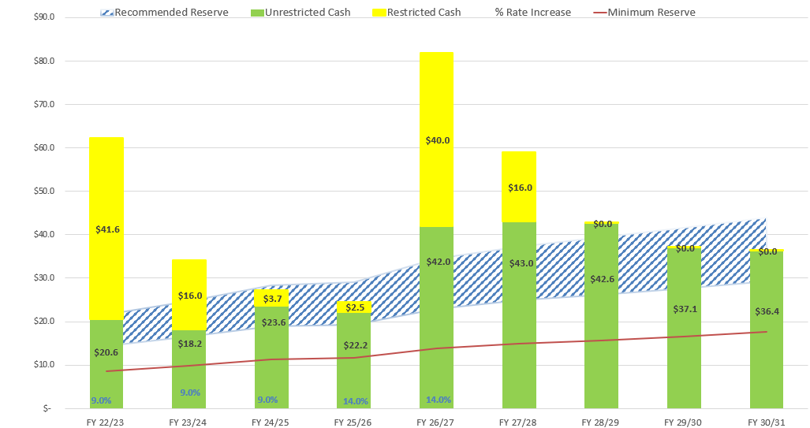
History & Forecast of Water Cash Reserves
($ in millions)
Notes:
Changes since March Board meeting:
updated with December actuals
updated with January actuals
updated FY 26/27 with updated O&M
cut new bond int exp in half - issued mid year water 26/27
interest rate income formula correction water
$2m a year for san diego water for 5 years asset , but net impact is $1m a year
updated capital - shifts no change in 10 year total
Potable CIP – Miscellaneous Facilities went down $5M in 30/31 due to:
• Please push back the $5m currently in FY 30-31 for Valley Pumping Plant Office/Lab Expansion back one year to FY 31-32.
Recycled CIP- Recycle water went down by $7.5m in 29/30 and $750k in 30/31 due to:
• For the Potable Reuse - Study/Program, please push back the $7.5m in FY 29-30, the $750k in FY 30-31, and for the 10 year forecast - $82.5m in FY 31-32 was pushed back 3 years to FY 32-33, FY 33-34, and FY 34-35 respectively.

Slide 10
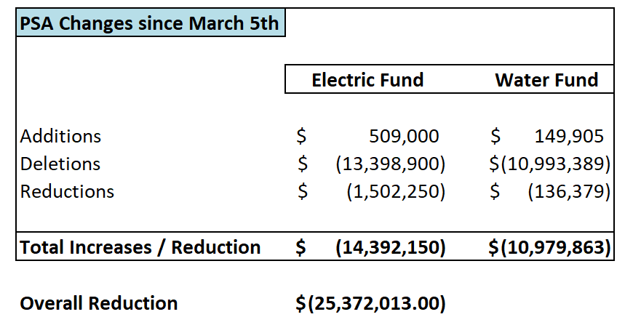
Reductions in PSA by Fund
*Reduction in PSA authority does not translate into a direct reduction of Budget Authority.

Slide 11

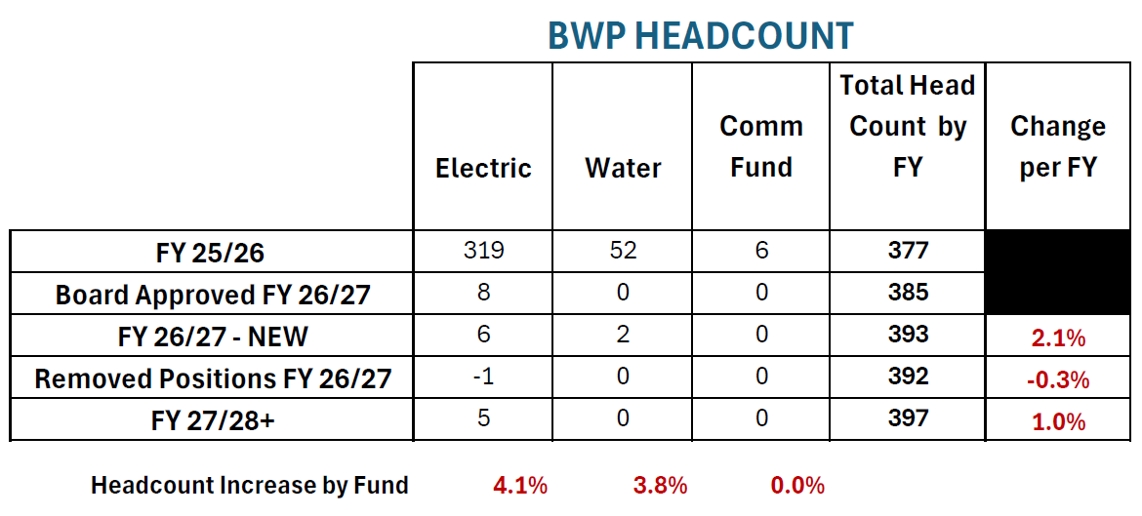

Position Budgeting
Notes:
New positions for FY 26/27 - Board Approved (8 TOTAL):
- Senior Sustainability Analyst (Proposed BMA)
Data Engineer
Principal Electrical Engineer
Power System Operator Supervisor
Line Mechanic-G (4)
New Positions - Pending Approval (8 TOTAL):
Power Plant Operator (2)
Water Quality Analyst
Water Inspector (Proposed BCEA)
Customer Service Representative - level III (2)
Field Service Representative (2)
*Removing AGM – Customer Service and Marketing
4 Upgrades - Board approved:
Storekeeper to Lead Storekeeper
Civil Engineering Assistant-BWP to Principal Civil Engineer-BWP
- Proposed job Z group to Asst GM (Riad) – completed
CSR II to FSR (already been approved, title upgrade)
FY 27/28 New Position Requests
Line Mechanic-G (3 – Approved)
Sr Utility Accounting Analyst (Approved)
Utility Accounting Analyst (Pending Approval)

Slide 12
Staff Recommendation
Staff is requesting that the BWP Board recommend approval of the utility’s proposed FY 2026-27 budget as presented tonight to the Burbank City Council for the electric fund (fund 496), the water fund (fund 497), the MPP operating fund (fund 483), the Tieton operating fund (fund 133), the street lighting fund (fund 129), and the communications fund (fund 535).

Slide 13

Questions?
Joseph Lillio
Chief Financial Officer
JLillio@BurbankCA.gov
(818) 238-3723 office

Slide 14
Budget Authority (March Board Meeting)
($ in 000’s) | Adopted FY 2025-26 | Original FY 2026-27 | Updated FY 2026-27 | Increase / (Decrease)
Electric Fund | $415,426 | $340,131 | $358,846 | $18,715
Water Fund | $71,956 | $93,276 | $98,314 | $5,038
Communications Fund | $6,642 | $5,985 | $6,543 | $558
Street Lighting Fund | $5,168 | $3,995 | $4,198 | $203
MPP Operating Fund (SCPPA) | $27,809 | $32,113 | $32,068 | ($45)
Tieton Operating Fund (SCPPA) | $2,183 | $2,290 | $2,375 | $85
Total Authority | $529,184 | $477,790 | $502,344 | $24,554
Notes:
Although there have been an increase in budget authority, the team have found savings and offset to ensure we remain net neutral and well within the approved rate increases.
Comm fund deferring capital spend to future years.

